Slide 1

Multicore DLX with coherence protocol – Mid Presentation
Project Name: Multicore DLX processor with MESI coherence protocol
Project Number: 3024
Project carried out at: University
Submitted by:
Yarin Koren
Yohai Shiloh
Project instructor approval signature:
Name: _Oren Ganon_

Slide 2
Multicore DLX with coherence protocol – Mid Presentation
Project Abstract
Development of a multicore processor based on the DLX architecture with MESI(stands for Modified, Exclusive, Shared, Invalid) cache coherence protocol
Accelerate computing using the multiple cores advantage to parallelized the execution of programs by the processor
Using the MESI protocol to ensure memory consistency for all the cores while using a common memory to guarantee the process correctness

Slide 3
Multicore DLX with coherence protocol – Mid Presentation
Project Abstract (Mid-project)
Development of a single core processor based on the DLX architecture(during the Advanced Computer Structure Lab)
Development of cache unit for the processor with full support of its architecture
Integrate the cache unit, customize the single core processor and validate its operation

Slide 4
Multicore DLX with coherence protocol – Mid Presentation
Updated Project Requirements
Deliverables and methods
Development of multicore DLX processor with MESI protocol for cache memory coherence
Using Verilog and schematic over Xilinx ISE platform to develop and verify the design
Demonstration of the final design using FPGA board

Slide 5
Multicore DLX with coherence protocol – Mid Presentation
Updated Project Requirements
Project requirements
Full support in the original DLX architecture
Cache size of 16 memory blocks of 16 words each
Speedup of 40% in the performance run time (relative to the single core processor)
Running in at least 60MHz clock frequency

Slide 6
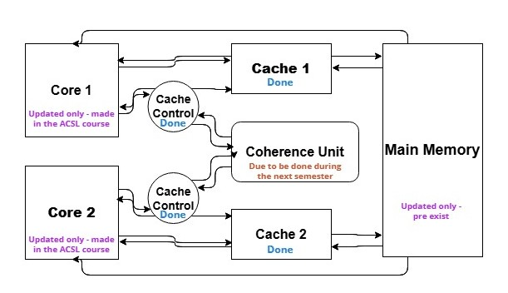
Multicore DLX with coherence protocol – Mid Presentation
Updated and elaborated block diagram
All the new blocks – cache and cache control was implemented in Verilog language on Xilinx platform
The core unit already designed and implemented during the ‘Advanced Computer Structure Lab course’ and was only connected to the new blocks (which designed to support the original core without modifications)
The cores, caches and cache control units are identical for both processors and therefore considered as done
The Main Memory was existed and only its content was updated, using the DLX architecture assembly code

Slide 7
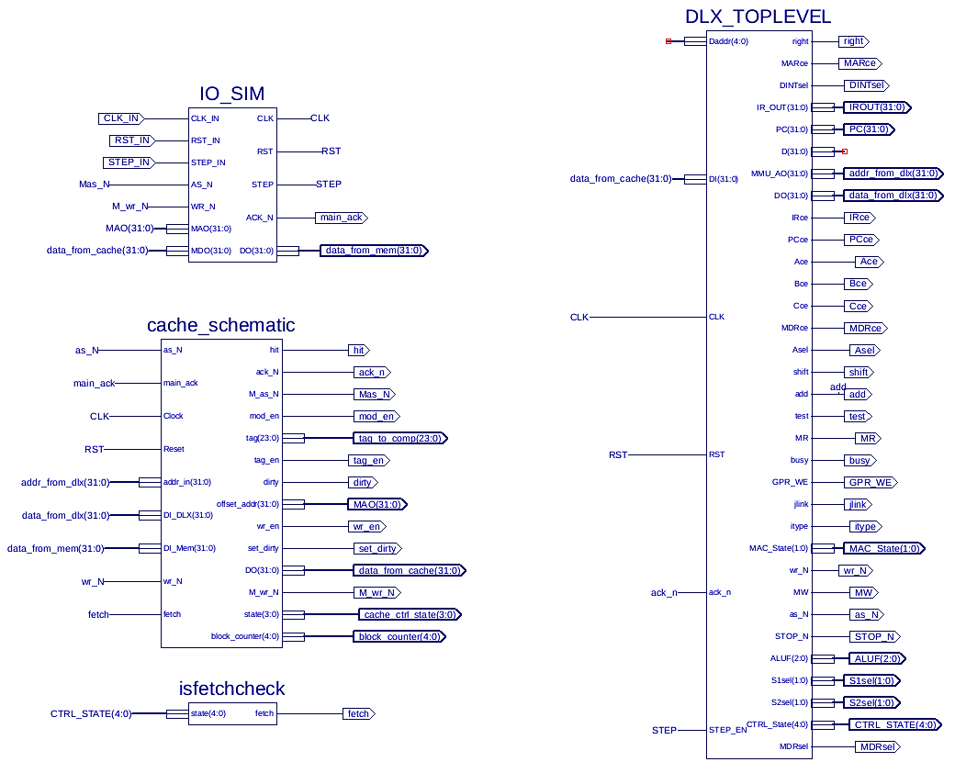
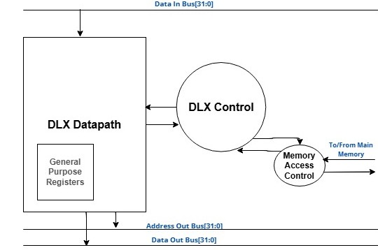
Multicore DLX with coherence protocol – Mid Presentation
Updated and elaborated block diagram
On the top – the DLX core block diagram(preexist)
On the left – the updated single core processor(with cache) blocks diagram and connectivity
The blocks:
DLX_TOPLEVEL – single core DLX(from the Advanced Computer Structure Lab)
Cache_schematic – core’s cache
Isfetchcheck – checking if DLX reads instruction
IO_SIM – Simulates main memory. Was given in the Advanced Computer Structure Lab

Slide 8
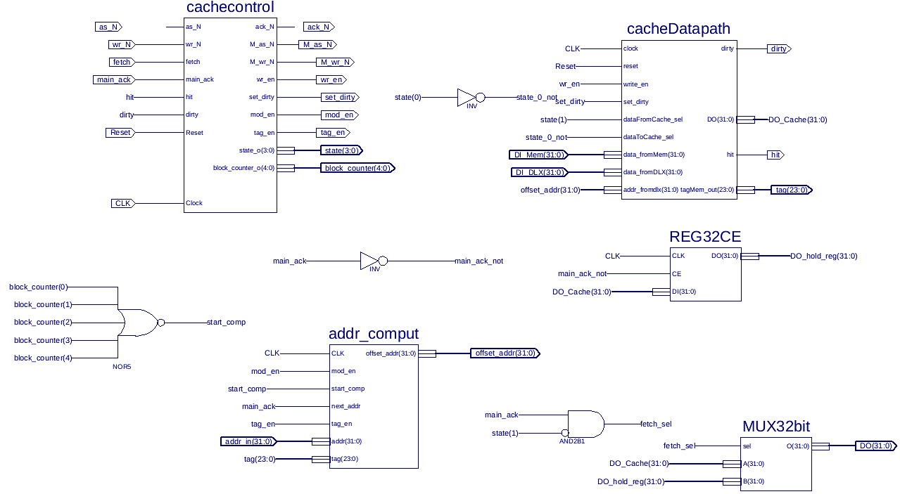
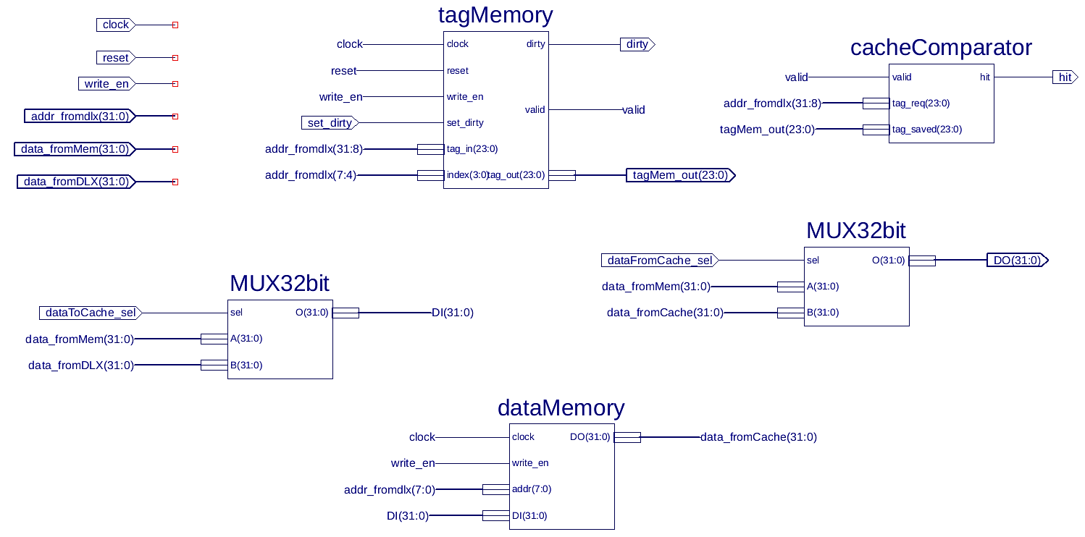
Multicore DLX with coherence protocol – Mid Presentation
Inside the cache
Cache inner structure scheme(left picture) contains the blocks:
‘cachecontrol’ – managing cache operation
‘addr_comput’ – calculate address wished to read from/write to
‘cacheDatapath’ – contains block’s data and tags. Its full structure detailed on the right side of the slide
Cache datapath block(right scheme) components:
‘tagMemory’ – contains blocks' tags in caches
‘dataMemory’ – contains cache data
‘cacheComparator’ – checks if we hit or missed the required block
All the blocks was implemented using Verilog HDL over Xilinx’s ISE software, except the ‘cacheDatapath’ block that implemented using the ISE’s schematic tools, the MUX32bit and the REG32CE blocks that was provided to us by the staff of the ACSL course and the basic logic gate, which is included in the ISE built-in library

Slide 9
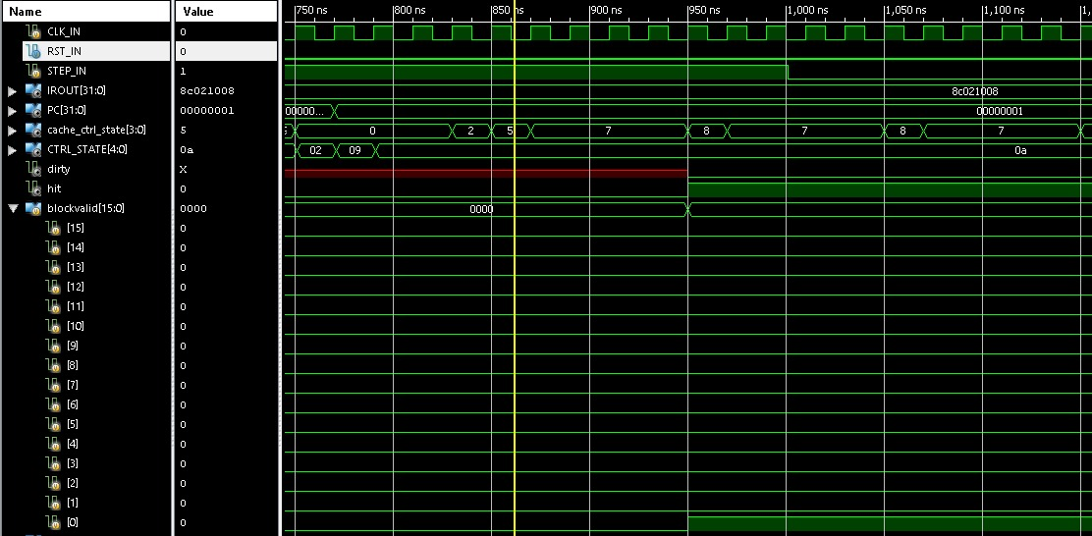
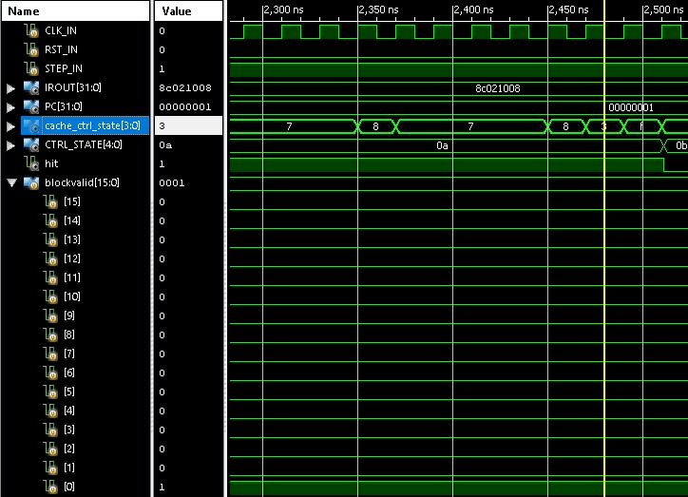
Multicore DLX with coherence protocol – Mid Presentation
Project products
LW Execution:
Reading block starts
LW instruction – reading word in block 0
hit = 0
Reading block ends
Valid = 0
Valid = 1

Slide 10
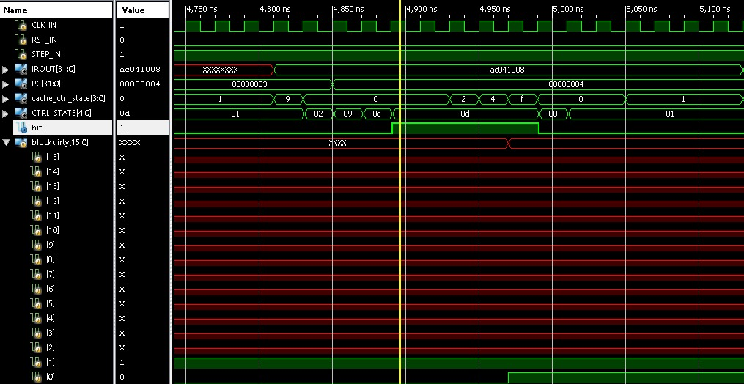
Multicore DLX with coherence protocol – Mid Presentation
Project products - continue
SW Execution:
SW instruction – storing word in block 0
hit = 1
dirty = 0
dirty = 1

Slide 11
Multicore DLX with coherence protocol – Mid Presentation
Project products – continue
Unachieved milestones
Running the program with the updated design on the FPGA board
quantized requirements
Full instruction support
Cache size of 16 blocks of 16 words (new)

Slide 12
Multicore DLX with coherence protocol – Mid Presentation
Updated schedule(past semester)
Remarks | Actual delivery date | Planned delivery date | Milestone
Revision of the original architecture and evaluate possible changes | 15.12.2024 | 8.12.2024 | Researching DLX
After considerations we designed the cache with no need to make changes in the original design |  | 22.12.2024 | Implementing DLX
Validation only after changes |  | 1.1.2025 | Simulate and verify DLX
 | 15.1.2025 | 12.1.2025 | Re-architecture the basic DLX, and adding cache memory
 | 25.1.2025 | 18.1.2025 | Writing benchmark in DLX assembly
Without running the design on the FPGA board | 6.2.2025 | 27.1.2025 | Simulating and verify DLX + cache
 | 13.2.2025 | 2.2.2025 | Progress Presentation Submission

Slide 13
Multicore DLX with coherence protocol – Mid Presentation
Updated schedule(next semester)
Remarks | Actual delivery date | Planned delivery date | Milestone
Verifying with the FPGA board – debt from past semester | 18.3.2025 | 27.1.2025 | Verify DLX with cache
Postponed due to the delay of the singled-core processor verifying | 23.3.2025 | 2.3.2025 | Designing multicore and researching MESI protocol
 | 30.3.2025 | 9.3.2025 | Implementation of the design and the protocol
 | 20.4.2025 | 23.3.2025 | Performance evaluation
 | 27.4.2025 | 20.4.2025 | Simulation and verification
 |  | 15.5.2025 | Performance analysis
 |  | 25.5.2025 | Poster Submission and finishing the work
 |  | 1.7.2025 | Documentation
 |  | 2.7.2025 | Final deliverables submission

